Slide 1
FitApp - Your Fitness Companion
Empowering Your Fitness Journey Anytime, Anywhere
Team
kareem alaa khalifa
Asmaa Ayman Mohamed
Mohamed magdy fouad
Mahmoud rafeeq abd elhamed
Ahmed Mohamed gafar
Instructor: Mohamed Elhabashy
Track: FrontEnd Developer track

Slide 2
What is FitApp?
A web platform that helps users track workouts, monitor nutrition, and set fitness goals.
Provides customized workout plans and health tips for all fitness levels.

Slide 3
Why FitApp ?(objective)
Many people struggle to maintain a consistent fitness routine due to a lack of time, motivation, or proper guidance.
Tracking workouts and nutrition can be time-consuming and confusing.

Slide 4
Technical Tools and libraries
HTML
CSS3
JS
React JS
jQuery
Wow js
React owl carousel

Slide 5
How FitApp Solves the Problem
Convenience: Accessible on any device, making it easy to use at home, the gym, or on the go.
Customization: Personalized workout and meal plans based on user preferences and fitness goals.
Community Support: Offers social features to connect users with fitness communities for motivation and challenges.

Slide 6
Key Features
User-Friendly Dashboard: Track workouts, nutrition, and progress.
Custom Workout Plans: Programs tailored for different fitness levels.
Nutrition Tracking: Log meals and receive dietary recommendations.
Goal Setting & Progress Monitoring: Set fitness targets and monitor achievements over time.

Slide 7
Target Audience
Fitness enthusiasts of all levels
Busy professionals looking for flexible workout options
People seeking personalized nutrition and fitness guidance
Gym-goers who want a digital companion for their routine

Slide 8
Design and User Interface
Intuitive Navigation: Easy-to-use interface, accessible for all ages.
Visual Progress Tracking: Graphs and charts to illustrate fitness progress.
Responsive Design: Works seamlessly on desktop, tablet, and mobile devices.

Slide 9
Competitor Analysis
Personalization: More customized fitness and nutrition plans compared to competitors.
Affordability: Offers competitive pricing with more features.
Community Features: Strong emphasis on connecting with other fitness enthusiasts.

Slide 10
Business Model
Freemium Model: Basic features for free, with premium plans for advanced workouts and nutrition plans.
• In-App Purchases: Additional features, workout programs, or one-on-one coaching.
Partnerships: Collaborations with gyms, trainers, or supplement brands for cross-promotions.

Slide 11
Marketing Strategy
Social Media Campaigns: Leverage Instagram, YouTube, and TikTok for fitness content and influencer collaborations.
SEO & Content Marketing: Publish blogs on fitness, nutrition, and wellness.
Email Marketing: Send personalized fitness tips and updates.

Slide 12
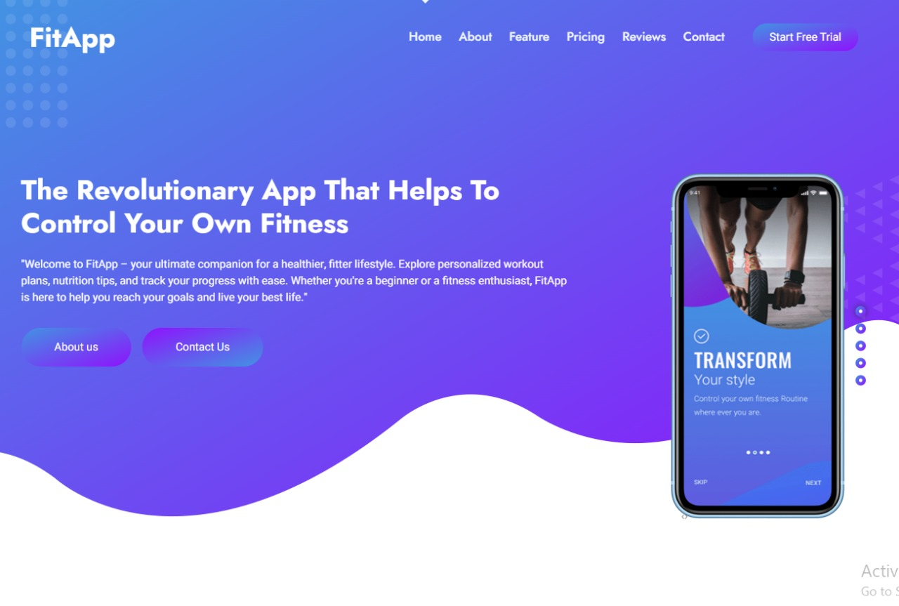
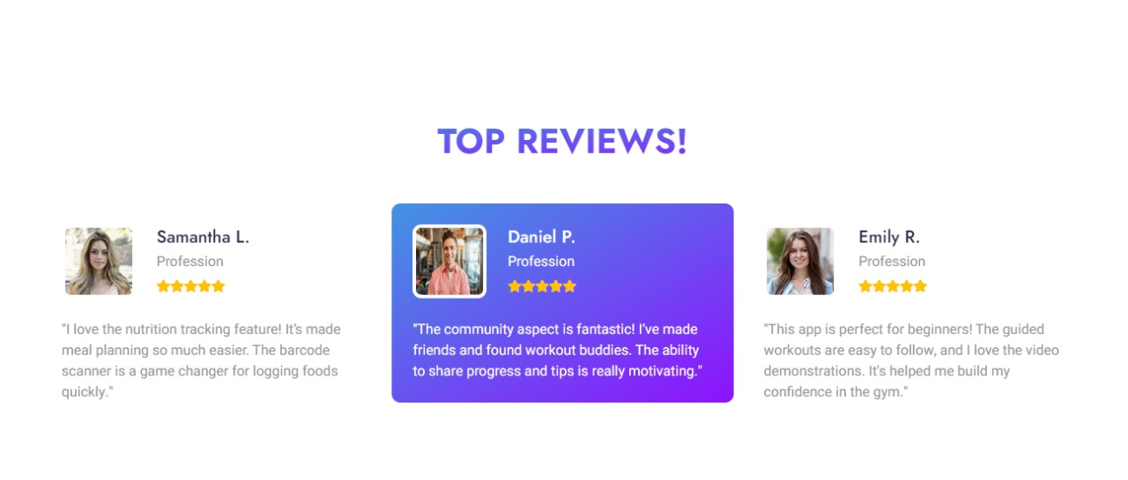
Demo Slide
Home

Slide 13
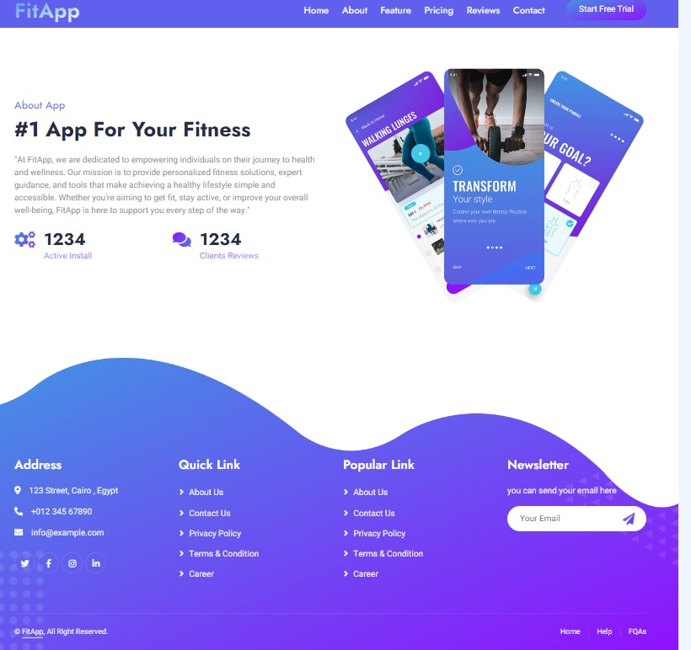
Demo Slide
About

Slide 14
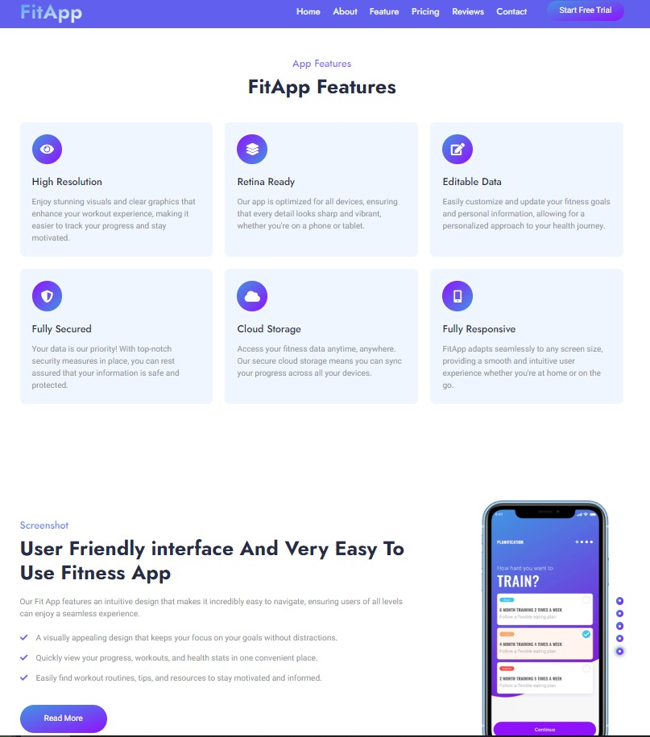
Demo Slide
Feature

Slide 15
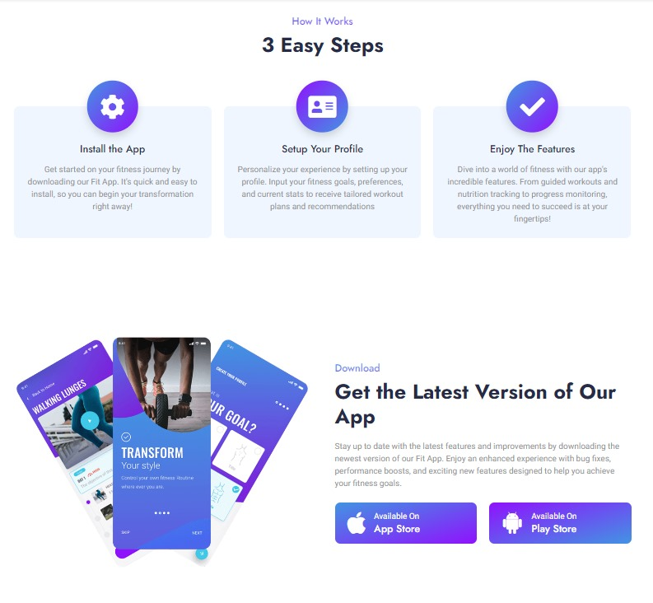
Demo Slide
Feature

Slide 16
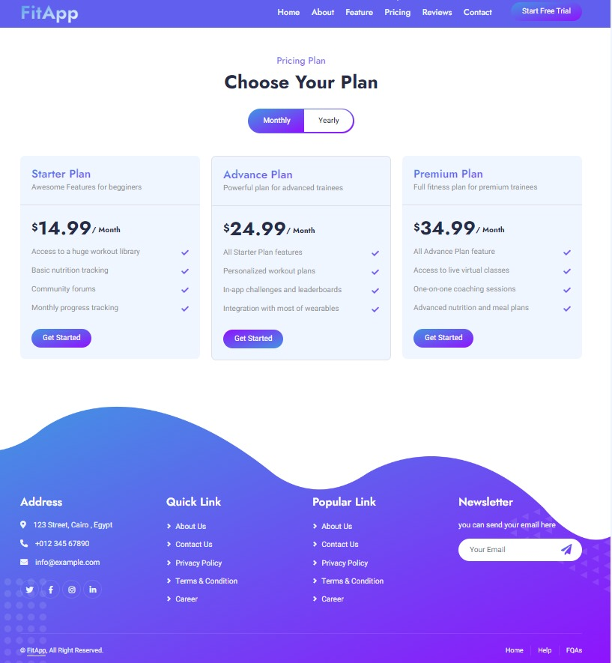
Demo Slide
Pricing

Slide 17
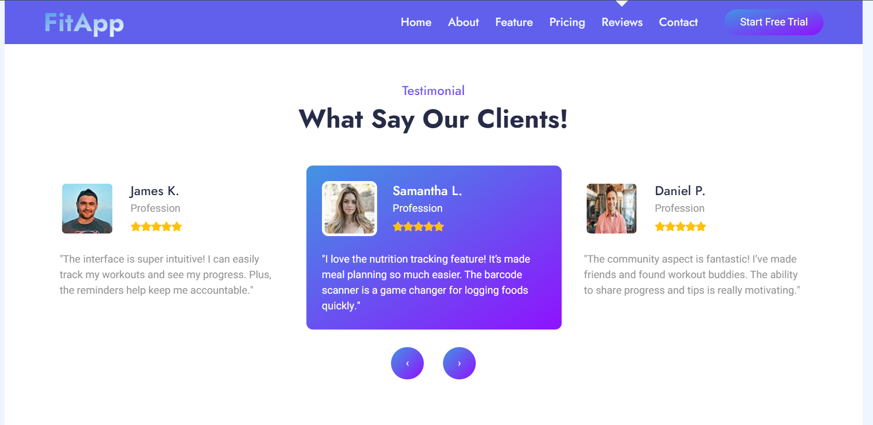
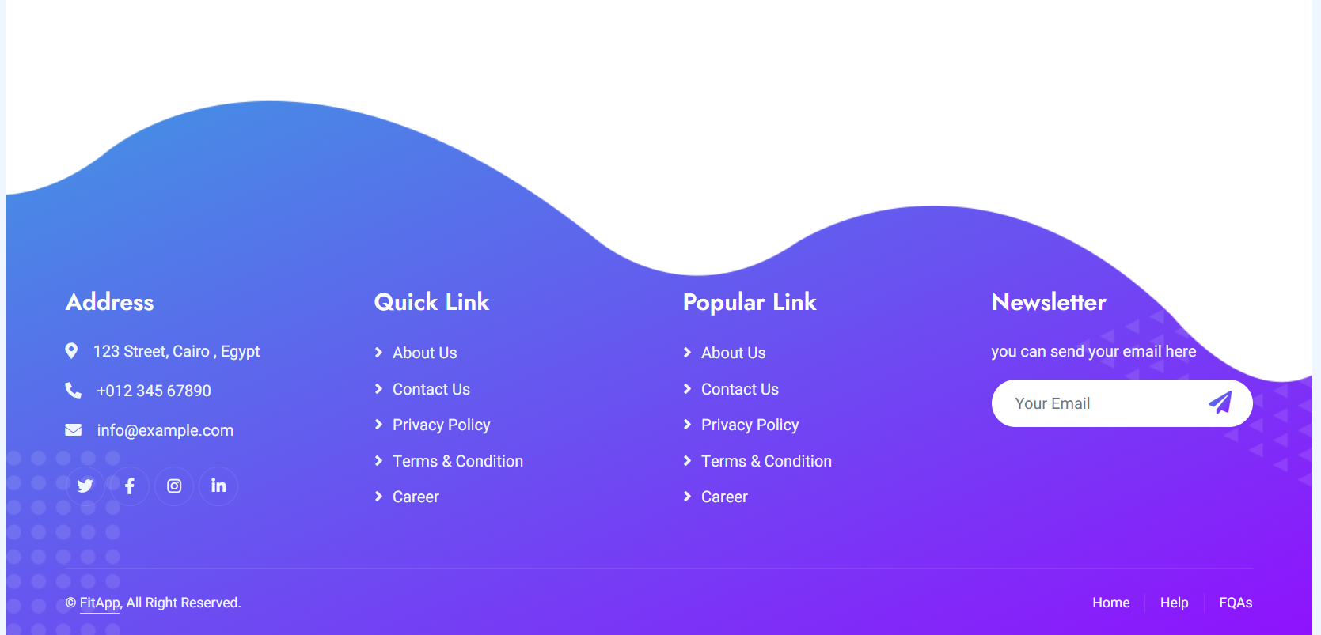
Demo Slide
Reviews

Slide 18
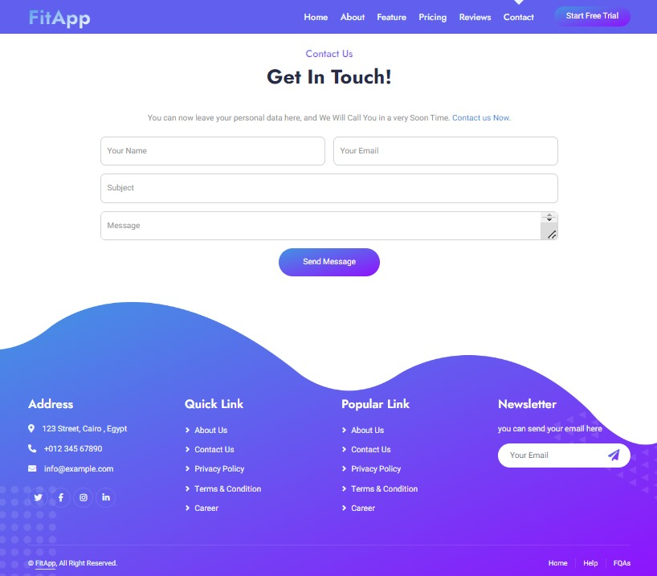
Demo Slide
Contact

Slide 19
Future Plans
New Features: Adding integration with wearables like Fitbit or Apple Watch.
AI-Powered Recommendations: Use machine learning to provide even better workout and nutrition plans.
Global Expansion: Expand the community and add multilingual support.

Slide 20
Big Thanks ☺
My Team
Our Instructor

